Slide 1
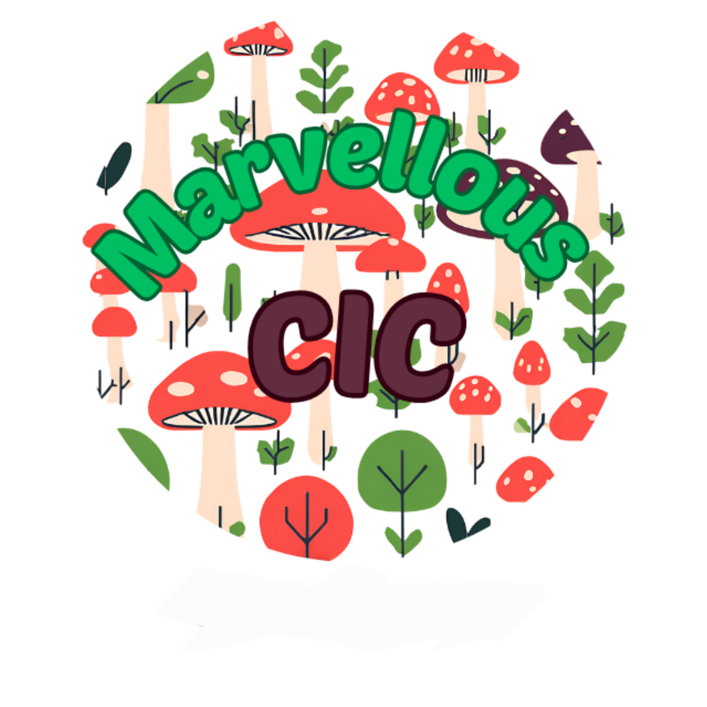
Dome Workshop
Notes:
Slide 1: Title Slide
Title: Grow All Year Round: Upcycled Dome Gardening for Flowers, Fruits, Vegetables & Herbs
Subtitle: A Workshop by Marvellous CIC
Image: Marvellous logo

Slide 2
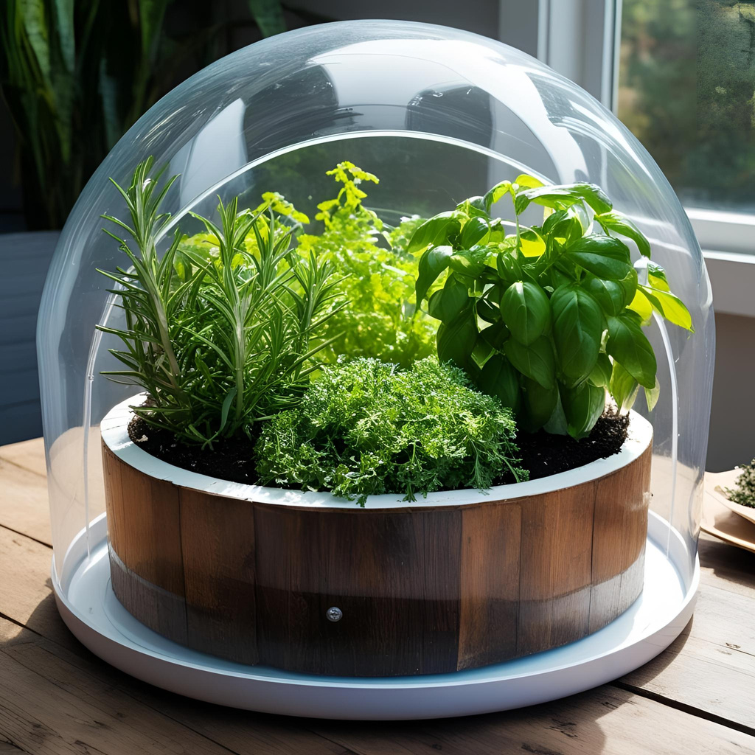
We're so glad you're here to explore the exciting possibilities of growing your own food and flowers in an upcycled dome
Notes:
Slide 2: Welcome!
Headline: Welcome to the Marvellous World of Year-Round Gardening!
Image: A friendly photo a welcoming scene.
Brief Welcome Message: "We're so glad you're here to explore the exciting possibilities of growing your own food and flowers in an upcycled dome!"

Slide 3

Who are we?
Beyond their innovative micro domes, Marvellous CIC demonstrates a remarkable commitment to the circular economy through a diverse range of other upcycled projects. These initiatives showcase their ingenuity and dedication to finding new life for discarded materials:
They are involved in making 3D printer filament from recycled plastics, transforming waste into a valuable resource for innovation and creation. This not only reduces plastic waste but also supports the growing field of 3D printing with sustainable materials.
Upcycled fish tanks are another fascinating project, likely repurposing plastic containers into functional and aesthetically pleasing aquatic habitats. This highlights their ability to find creative and practical applications for discarded items.
Furthermore, Marvellous CIC is exploring vertical hydroponics systems built from upcycled materials. This combines their expertise in sustainable food production with their upcycling ethos, creating efficient and space-saving methods for growing food in urban environments.
Notes:
Slide 3: Meet Marvellous CIC
Headline: Who We Are
Bullet Points:
Briefly explain Marvellous CIC's mission (community, sustainability, etc.).
Mention any relevant past projects or areas of expertise.
Image: Marvellous CIC logo or a photo showcasing their work.

Slide 4
Today's Green Adventure
  The benefits of year-round gardening.
  The magic of the upcycled dome.
  Sourcing materials and basic dome design.
  Growing flowers, fruits, vegetables, and herbs in the dome.
  Soil, watering, light, and ventilation tips.
  Organic pest and disease management.
  Simple plant propagation.
Notes:
Slide 4: Today's Green Adventure
Headline: What We'll Discover Today
Bullet Points:
The benefits of year-round gardening.
The magic of the upcycled dome.
Sourcing materials and basic dome design.
Growing flowers, fruits, vegetables, and herbs in the dome.
Seasonal planting strategies.
Soil, watering, light, and ventilation tips.
Organic pest and disease management.
Simple plant propagation.
Image: A visual representation of the topics covered (e.g., icons or small photos).

Slide 5
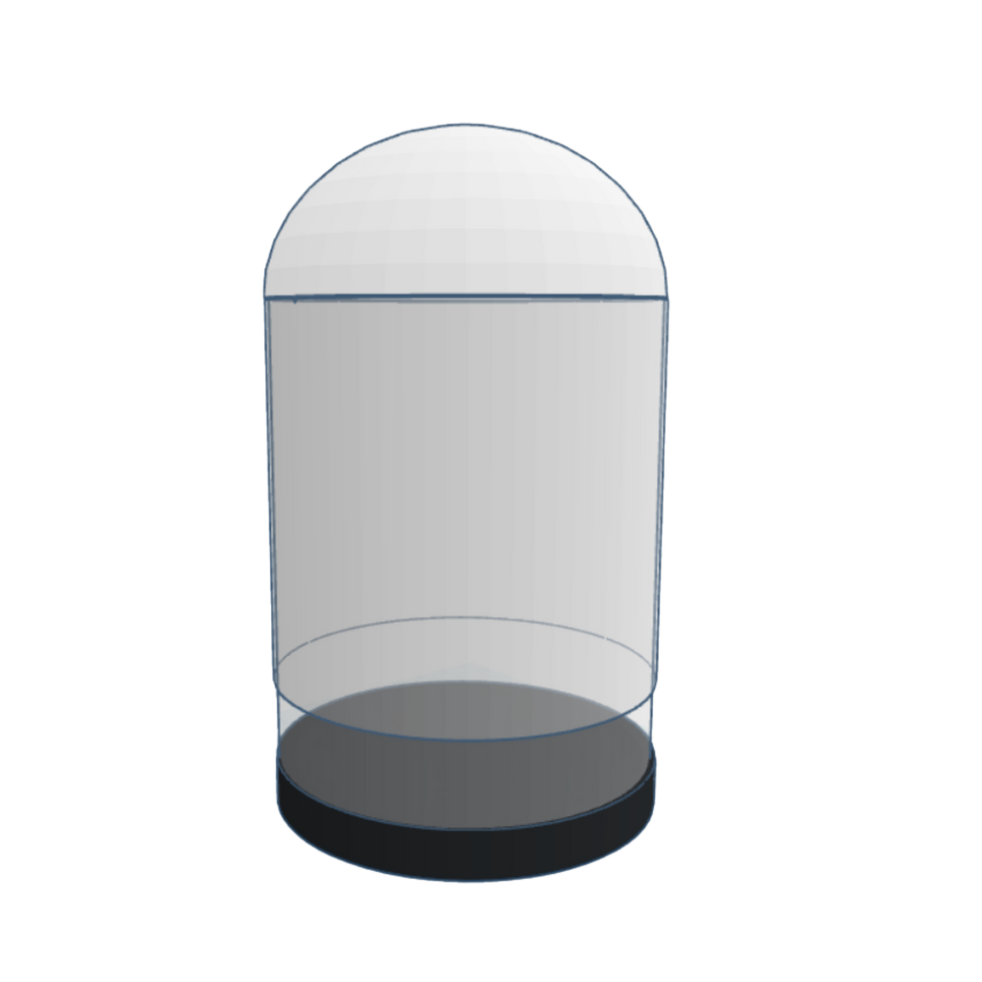
Creating a micro-climate
Notes:
The Dome's Microclimate Magic
Headline: Creating the Perfect Growing Environment
Bullet Points:
Temperature regulation.
Humidity control.
Protection from wind and pests.
Trapping solar energy.
Image: A diagram illustrating how sunlight and heat are trapped within a dome.

Slide 6
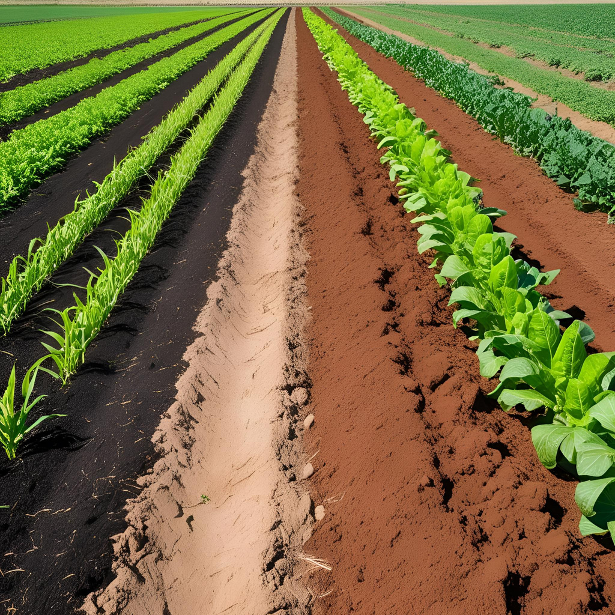
The Foundation for Growth
  Choosing the right soil mix for dome gardening.
  Watering techniques in a protected environment (avoiding overwatering).
  Importance of drainage.
Notes:
Slide 6: Happy Plants: Soil & Watering
Headline: The Foundation for Growth
Bullet Points:
Choosing the right soil mix for dome gardening.
Watering techniques in a protected environment (avoiding overwatering).
Importance of drainage.
Image: Healthy soil and someone watering plants.

Slide 7
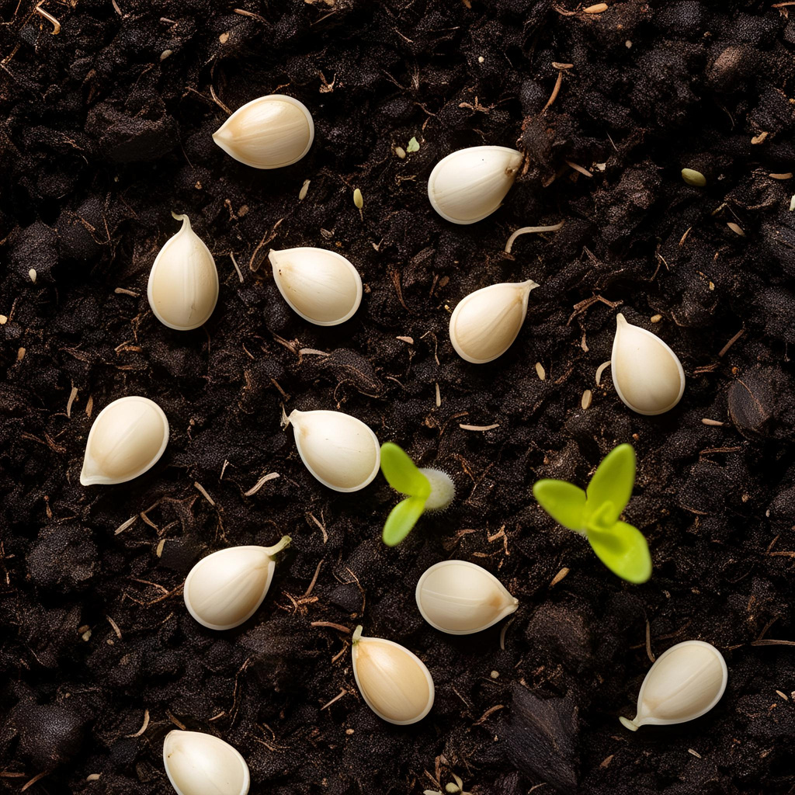
Expanding Your Green Family
  Propagation methods cuttings and seeds
  Benefits of propagating your own plants.
Notes:
Slide 7: Grow More for Free: Propagation
Headline: Expanding Your Green Family
Bullet Points:
Briefly explain simple propagation methods (cuttings, seeds).
Benefits of propagating your own plants.
Image: Someone taking a cutting or sowing seeds.

Slide 8
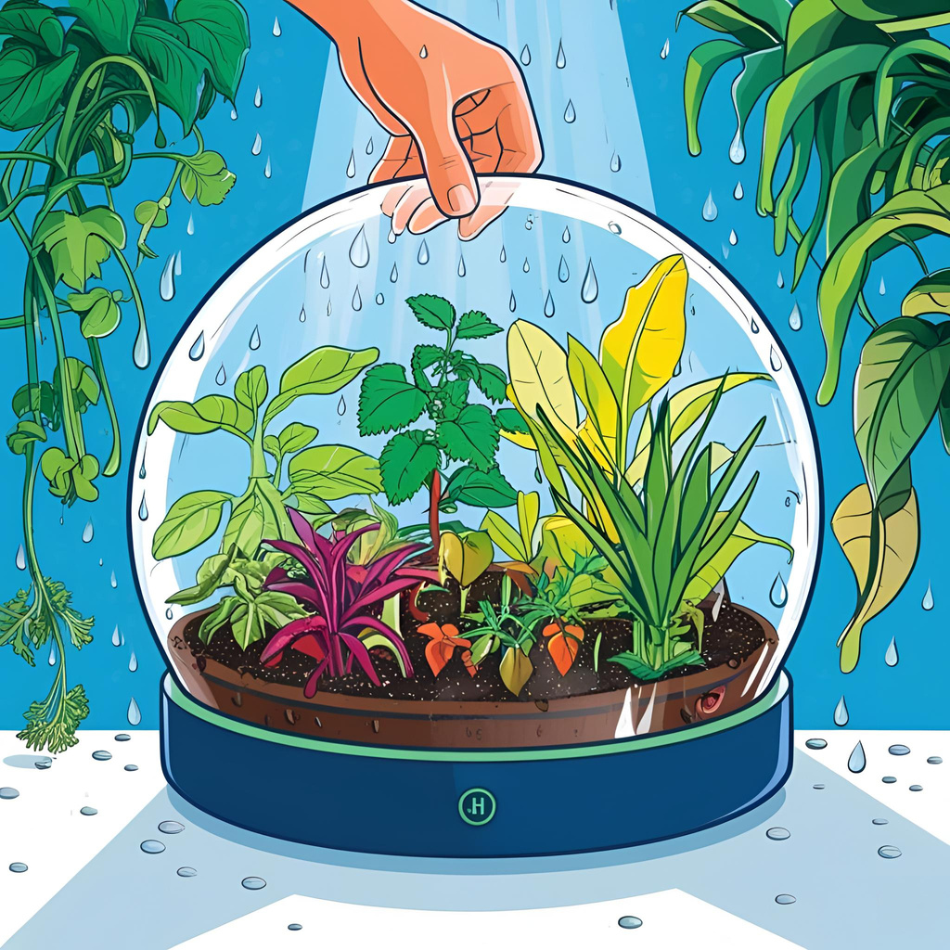
Let's Get Our Hands Dirty!
  Liner!
  Soil!
  Seeds!
  Water/Spray!
  Lid!
Notes:
Headline: Let's Get Our Hands Dirty!
Image: Photo of dome
Brief Instructions: Practical activity.

Slide 9
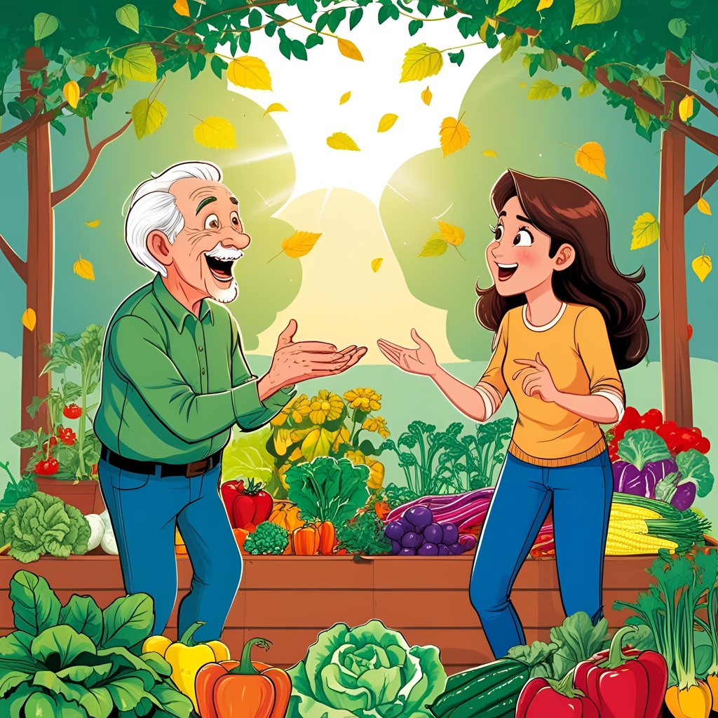
Your Thoughts & Ideas
Notes:
Slide 9: Questions & Sharing
Headline: Your Thoughts & Ideas
Text: "What questions do you have? Let's share our ideas and inspiration!"
Image: An open and inviting image.

Slide 10
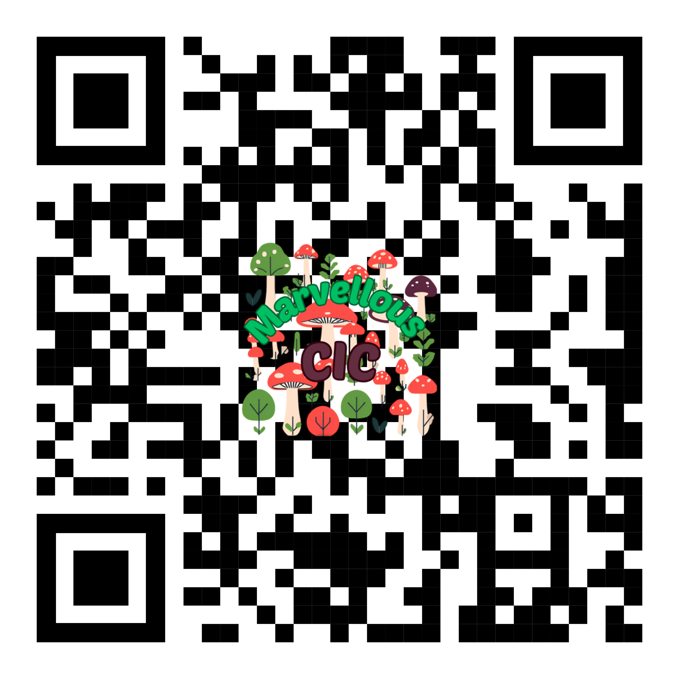
Thank You for Joining Us!
We hope you're feeling inspired to creating your own year-round upcycled dome garden.
Connect with us!
Notes:
Thank You for Joining Us!
Brief Thank You Message: "We hope you're feeling inspired to create your own year-round upcycled garden!"
Marvellous CIC Contact Information (Website, Social Media)
Feedback Request (Optional): How can we improve?
Image: Marvellous CIC logo and a final inspiring image.

